Slide 1
2017 ENIGMA ENHANCED TASTING PROGRAM

Slide 2
The Inspiration
The perfect wine for the premium wine treasure hunter
Enigma exceeds expectations in both taste and price
First it intrigues you, then it surprises and delights you
Enigma is a ‘find’ worth sharing with friends
Goals for 2017
Drive trial in store while focusing on sales
Communicate the brand essence while tasting the product
Increase trial by creating an experience
Increase conversion rates by 10-15%
Execution
30-40 Events in total
5 British Columbia + 10 Alberta + 10-20 Ontario + 5 Quebec
February/March (Easter), May (Mother’s Day) & Holiday
$450/Tasting target
The Focus

Slide 3
How Intriguing…
It is the beginning of eternity,
the end of time and space,
the beginning of the end
and the end of the human race…
What is it?

Slide 4
Create an eye-catching and plentiful bottle display, attracting guests to the tasting.
Place an easel-back with the riddle alongside the food component to immediately intrigue the consumer.
Place one bottle of each varietal at the centre with a “How Intriguing…” neck tag that reveals the price of the wine on the other side.
The Concept
Notes:
We love the idea of building an in-store experience
Have a lot of really great, exciting ideas that would not only be very memorable but would extend beyond the confines of the tasting
But with only a small number of events, big ideas wouldn’t have the big impact needed to justify a big investment
Not to mention that an in-store experience also means talking to fewer people which would results in lower sales which would actually hurt the brand

Slide 5
The BA will engage every customer as they walk in.
They will ask, “Are you on the hunt for a premium tasting wine at an affordable price?”, while nodding to subtly influence the guest’s response.
The BA will share the flavour profile of the wine while the customer enjoys their sample.
The customer, reaching for their food sample, is immediately intrigued by the riddle - what could the answer be?
The customer will be asked to guess the price of the wine and will be surprised and delighted when the BA reveals the true price on the neck tag.
The BA will close the sale by extending the customer a bottle, sharing the LTO (if applicable) to create a sense of urgency to purchase.
And, (oh how delightful!) they will receive this branded aroma/flavour wheel as a unique gift with purchase!
The riddle will be printed on the back of the wheel so that they can share it with their friends.
Share your answer on Facebook/Instagram for a sweet surprise!
The Execution
Notes:
We love the idea of building an in-store experience
Have a lot of really great, exciting ideas that would not only be very memorable but would extend beyond the confines of the tasting
But with only a small number of events, big ideas wouldn’t have the big impact needed to justify a big investment
Not to mention that an in-store experience also means talking to fewer people which would results in lower sales which would actually hurt the brand

Slide 6
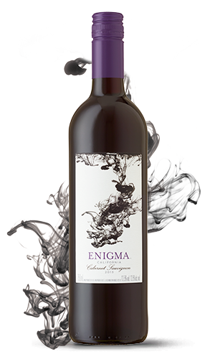
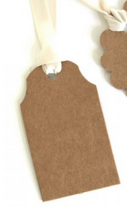
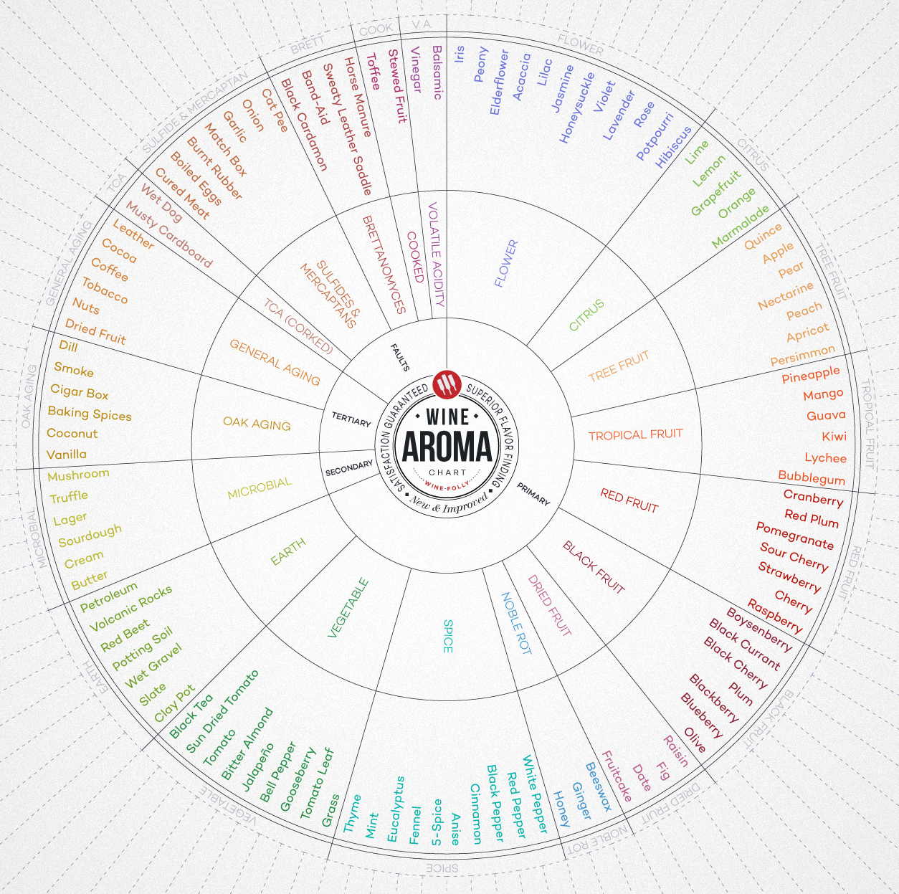
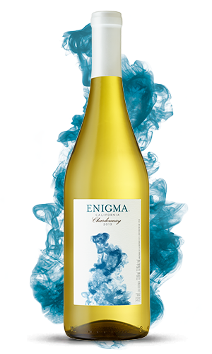
How Intriguing…
The Visual
It is the beginning of eternity, the end of time and space, the beginning of the end, and the end of the human race. What is it?
Enigma Wine
enigmawine_ca
Only $13.95!

Slide 7
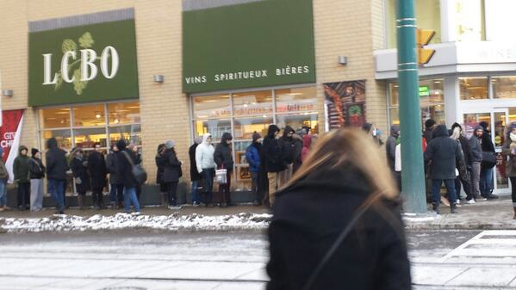
Amplification
Onsite camera/media
Digital influencer campaign
Social media channels (Twitter, Instagram, Facebook)
Newspaper (METRO)
Radio (send bottles and story to hosts)
Other Extensions:
Canadian Special Events Magazine
Lioness Women’s Club
Huffington Post
Cambria
Glen Peloso celebrity designer social media
Personal social media channels
Treasure Found at the LCBO
People were lined up this morning at the Summerhill LCBO to pick up a bottle of Enigma wine from California. With people on the hunt for a premium wine at a value price, it’s not difficult to understand the buzz about this wine.
“I am always looking for a great tasting wine without the big price tag,” said one customer who had been waiting in line since 8:30AM. “Enigma is a real treasure and I only hope they don’t run out any time soon. I’ll probably buy a couple of cases.”
Enigma wines can be found in the California section at the LCBO for only $13.95 per 750mL bottle. But you should move quickly - it’s on limited time offer for only $11.95 until the end of the week.
PR Stunt

